Slide 1
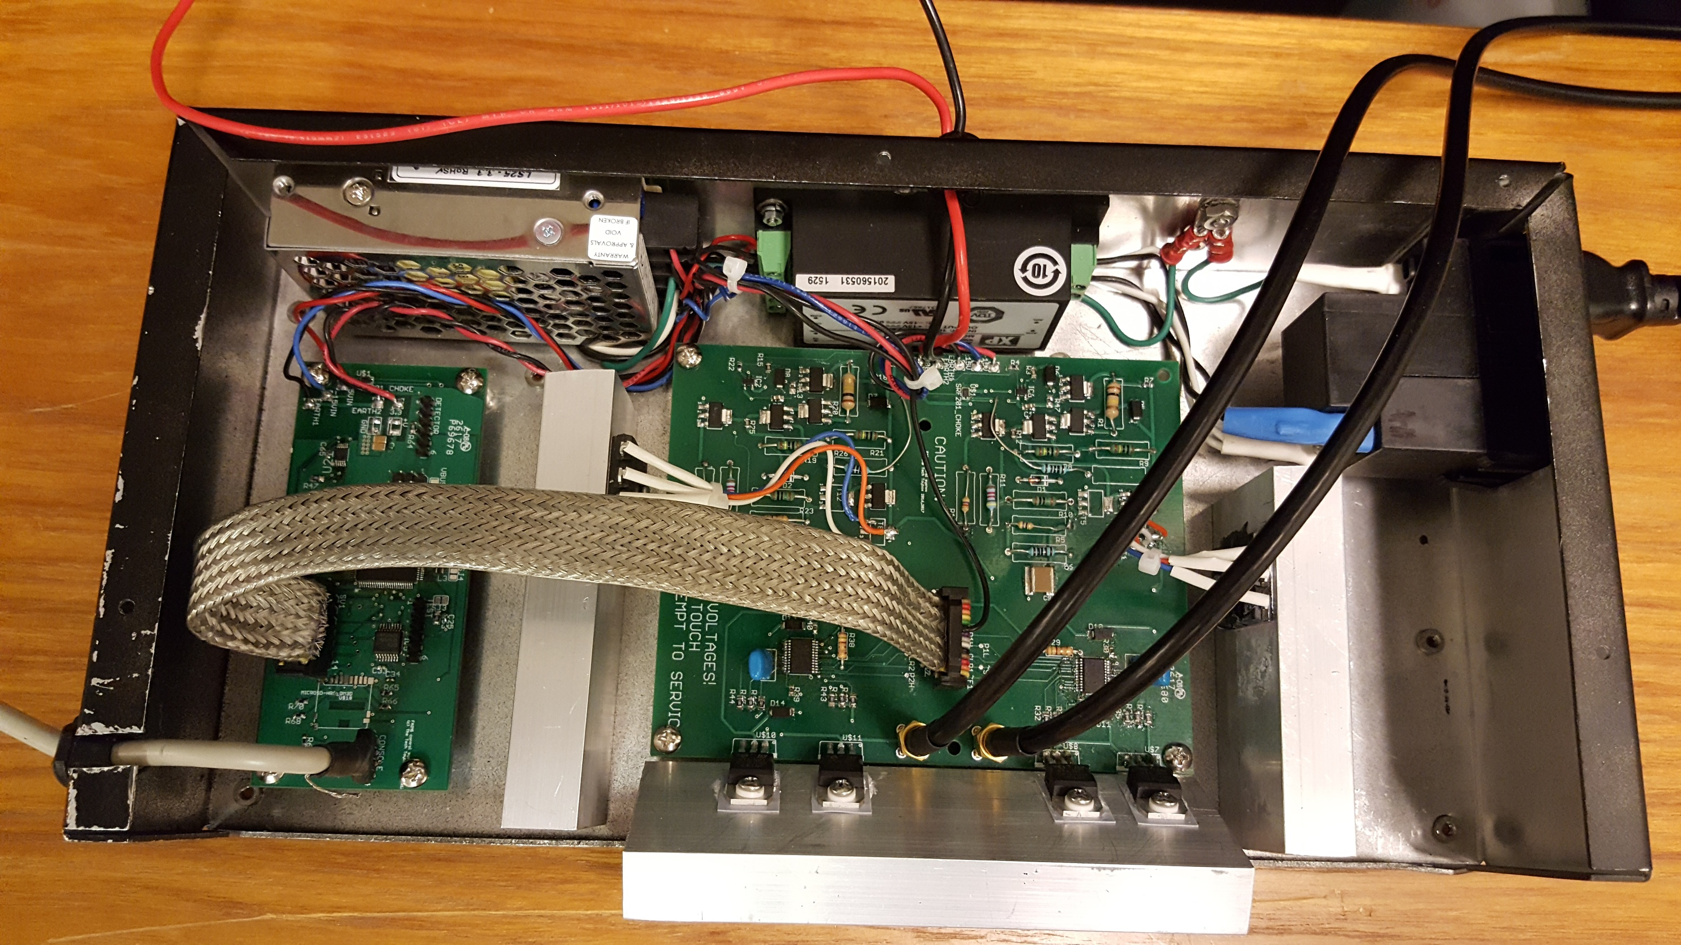
Extend height of box for cooling
Extend length of grounding bolt for DBD screen and XYZ stage/mounting rail
Wire detector board to +/- 15V
Install Fan
Possible location for detector board
(fits vertically)
Extend length of box to make room for heat sinks, internal HV power supply (currently 2cm² plus transformer), and DBD transformer
Install Fan on this end as well

Slide 2
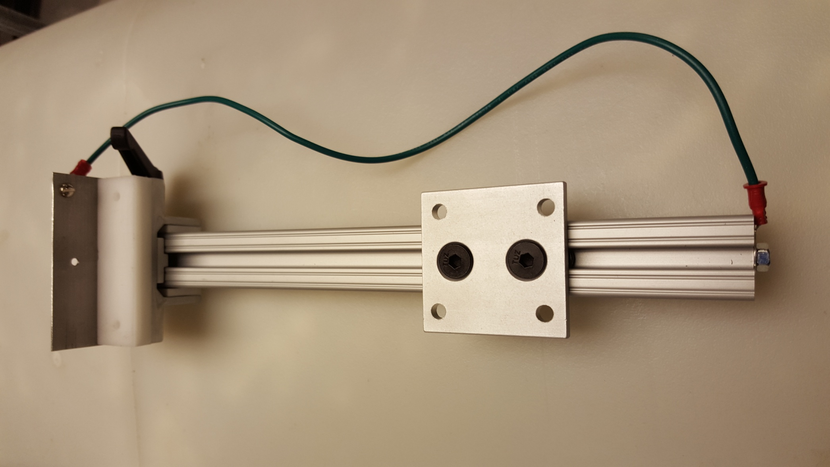
Will do some experiments to look at stand-alone instrument holding the DBD, FAIMS, and detector plate on second layer of box using this rail system as the basis

Slide 3
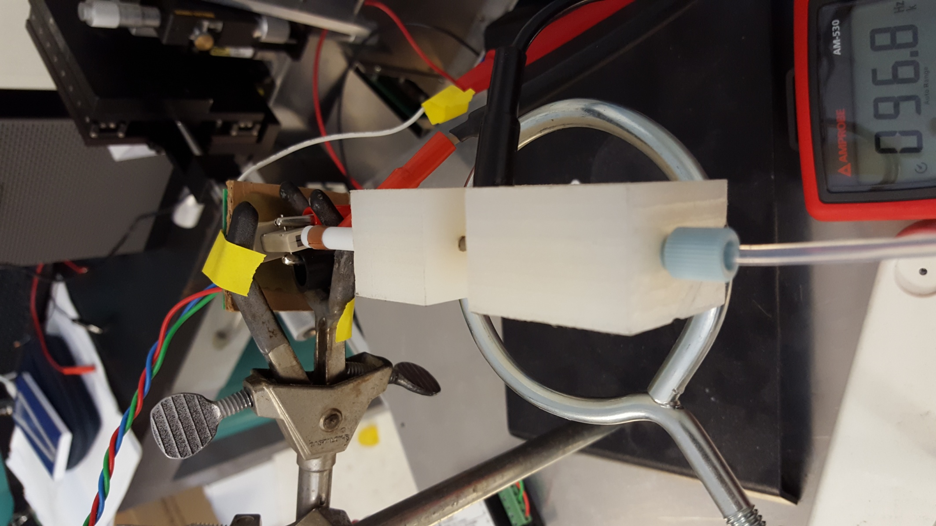
Earlier stand-alone
experimental setup

